Slide 1
Homomorphic Commitments & Signatures
Daniel Wichs
Northeastern University
based on work with: Sergey Gorbunov and Vinod Vaikuntanathan

Slide 2
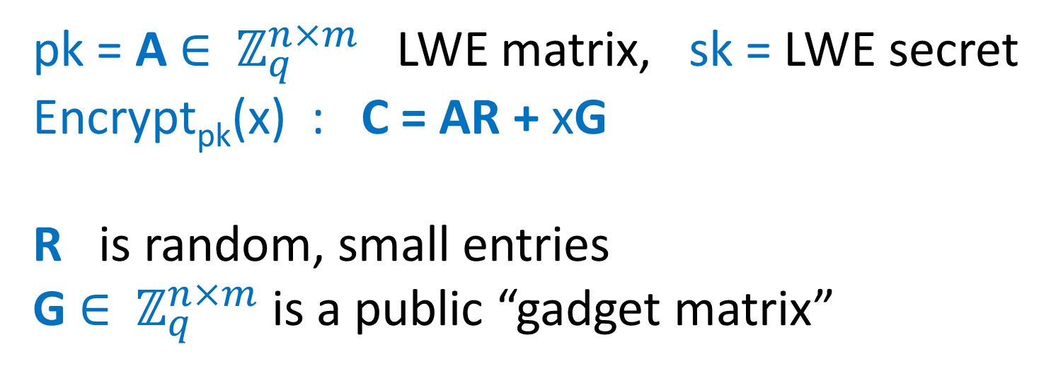
Recall the GSW FHE
pk = A $∈$ $ℤ_{q}^{n×m}$ LWE matrix, sk = LWE secret
Encrypt_{pk}(x) : C = AR + xG
R is random, small entries
G $∈$ $ℤ_{q}^{n×m}$ is a public “gadget matrix”

Slide 3
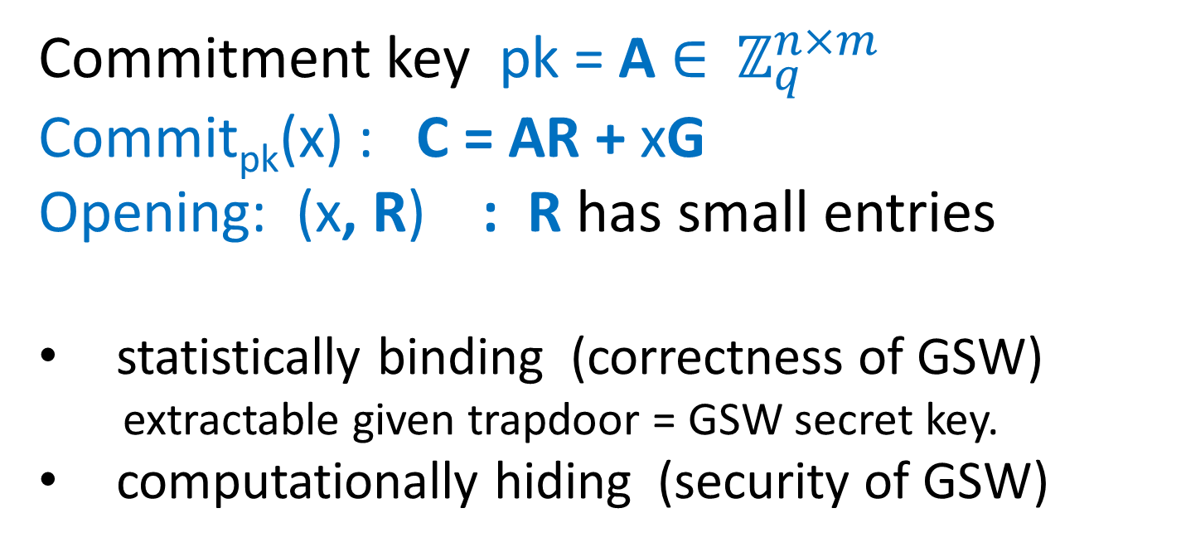
GSW as a Commitment
Commitment key pk = A $∈$ $ℤ_{q}^{n×m}$
Commit_{pk}(x) : C = AR + xG
Opening: (x, R) : R has small entries
statistically binding (correctness of GSW)
extractable given trapdoor = GSW secret key.
computationally hiding (security of GSW)

Slide 4
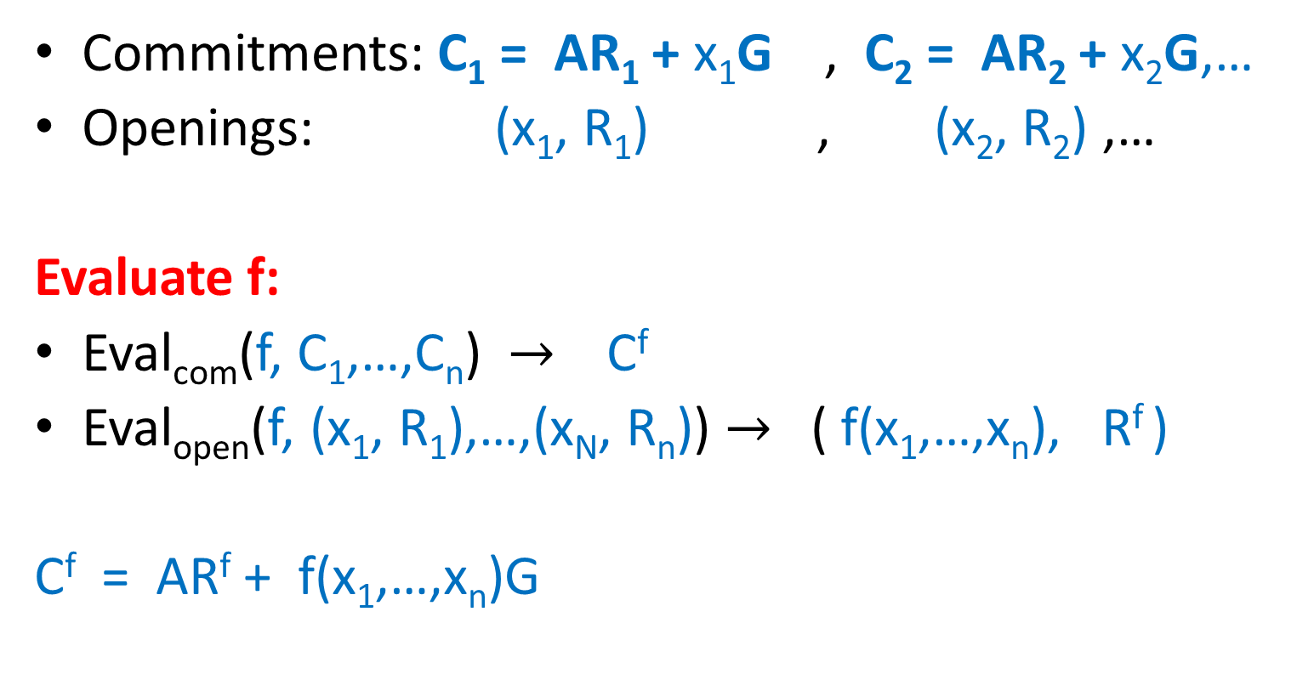
Homomorphic Computation on Commitments and Openings
Commitments: C₁ = AR₁ + x₁G , C₂ = AR₂ + x₂G,…
Openings: (x₁, R₁) , (x₂, R₂) ,…
Evaluate f:
Eval_{com}(f, C₁,…,C_{n}) $→$ C^{f}
Eval_{open}(f, (x₁, R₁),…,(x_{N}, R_{n})) $→$ ( f(x₁,…,x_{n}), R^{f} )
C^{f} = AR^{f} + f(x₁,…,x_{n})G
Might reveal extra info about x₁,…,x_{n}.
(can remove this)

Slide 5
Homomorphic Computation on Commitments and Openings
Commitments: C₁ = AR₁ + x₁G , C₂ = AR₂ + x₂G
Openings: (x₁, R₁) (x₂, R₂)
Addition:
Eval_{com} C⁺ = C₁ + C₂
Eval_{open} ( x₁ + x₂, R₁ + R₂)
C⁺ = ( AR₁ + x₁G ) + ( AR₂ + x₂G ) = A(R₁+R₂) + (x₁+x₂)G

Slide 6
Homomorphic Computation on Commitments and Openings
Commitments: C₁ = AR₁ + x₁G , C₂ = AR₂ + x₂G
Openings: (x₁, R₁) (x₂, R₂)
Multiplication:
Eval_{com} C^{x} = C₁ G⁻¹(C₂)
Eval_{open} (x₁x₂, R₁ G⁻¹(C₂) + x₁R₂)
C^{x} = (AR₁ + x₁G) G⁻¹(C₂) = (AR₁ G⁻¹(C₂) + x₁(AR₂ + x₂G)
= A(R₁ G⁻¹(C₂) + x₁R₂) + x₁x₂G

Slide 7
Two Flavors of Commitments
Commit_{pk}(x) : C = AR + xG
A is chosen as in GSW:
computationally hiding (LWE).
statistically binding.
extractable using trapdoor.
A is chosen uniformly random:
scheme is statistically hiding, commitments are uniformly random.
computationally binding (SIS or LWE)
equivocal using a trapdoor (next)
B
A =
b = sB+e
A =

Slide 8
SIS Trapdoor [Ajtai99,…,MP12]
Goal: choose a random A with a trapdoor such that for any V can find short R : AR = V.
R = TG⁻¹(V)
To open commitment C to a bit x, set V = C – xG.
m/2
m/2
Trapdoor:
T =
-R*
A =
B
BR* + G
n
I
AT = G

Slide 9
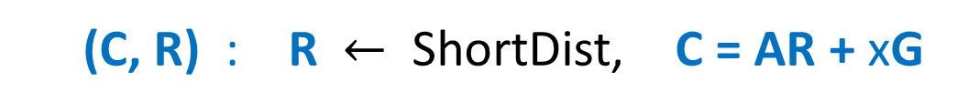
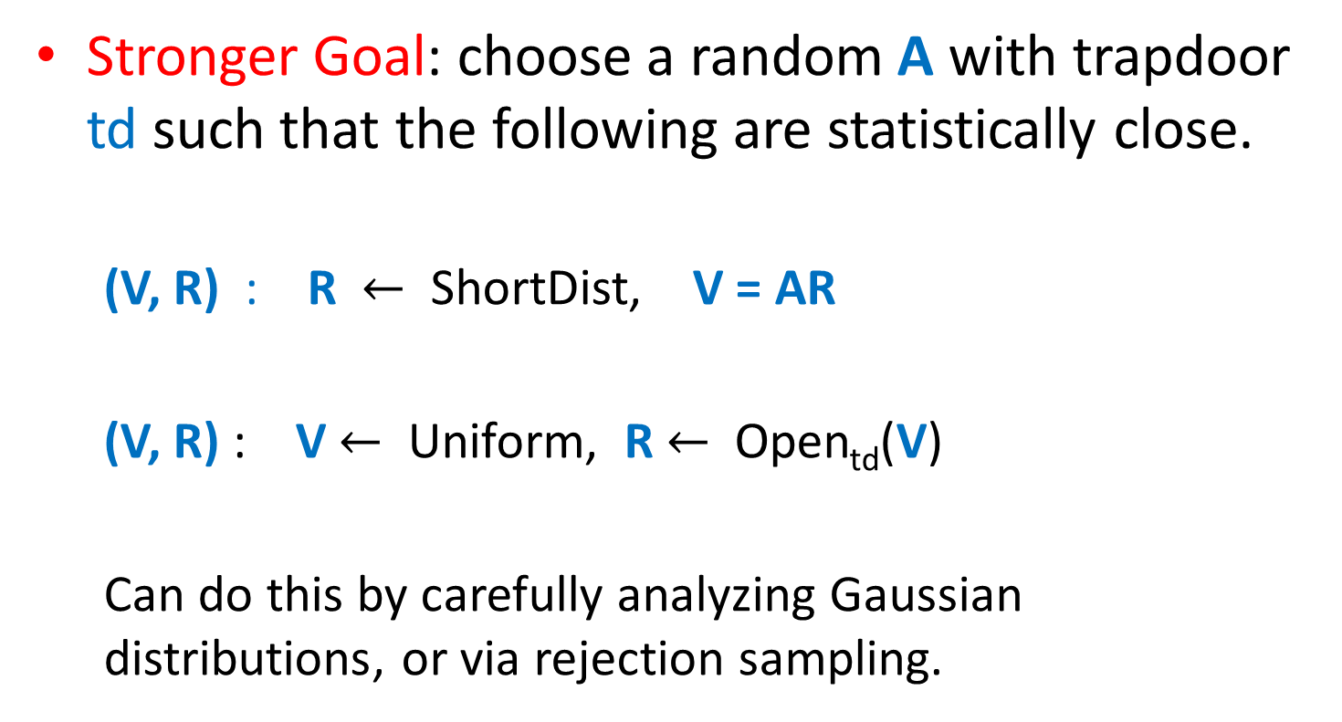
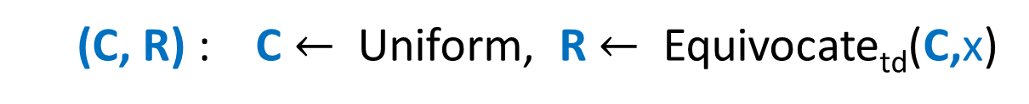
SIS Trapdoor with Correct Distribution [GPV08, MP12, LW15]
Stronger Goal: choose a random A with trapdoor td such that the following are statistically close.
(V, R) : R $←$ ShortDist, V = AR
(V, R) : V $←$ Uniform, R $←$ Open_{td}(V)
Can do this by carefully analyzing Gaussian distributions, or via rejection sampling.
(C, R) : R $←$ ShortDist, C = AR + xG
(C, R) : C $←$ Uniform, R $←$ Equivocate_{td}(C,x)

Slide 10
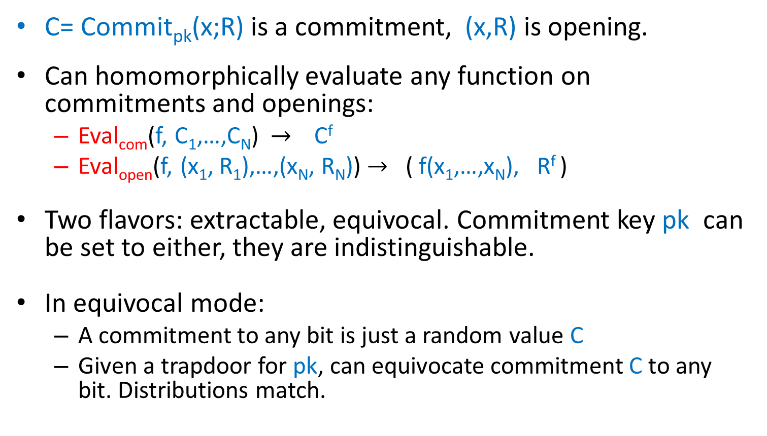
Summary: Homomorphic Commitments
C= Commit_{pk}(x;R) is a commitment, (x,R) is opening.
Can homomorphically evaluate any function on commitments and openings:
Eval_{com}(f, C₁,…,C_{N}) $→$ C^{f}
Eval_{open}(f, (x₁, R₁),…,(x_{N}, R_{N})) $→$ ( f(x₁,…,x_{N}), R^{f} )
Two flavors: extractable, equivocal. Commitment key pk can be set to either, they are indistinguishable.
In equivocal mode:
A commitment to any bit is just a random value C
Given a trapdoor for pk, can equivocate commitment C to any bit. Distributions match.

Slide 11
Homomorphic
Encryption
extractable
Homomorphic
Commitments
Homomorphic
Signatures
equivocal

Slide 12




Homomorphic Signatures: Motivation
Alice
Cloud Server
Bob
x
y=f(x)
y
x = (x₁, …, x_{n})
large database
program
Notes:
Small query: can look at parts of the database, does not need to read the entire input.
Where does P come from? Cloud and Bob agree on P somehow. Either cloud server chooses P and sends it to Bob, or Bob chooses P and sends it to cloud. In either case,

Slide 13
communication
computation
HOMOMORPHIC
ENCRYPTION
ENCRYPTION
HOMOMORPHIC
privacy
SIGNATURES
verifiability
SIGNATURES
Notes:
Let’s brainstorm and see how we can solve this problem…
No dataset, database everywhere.

Slide 14
Homomorphic Signatures (HS)
Is y=f(x)
???
Alice (sk)
Cloud Server
Bob (pk)
x, σ
y=f(x)
σ_{f,y}=Eval_{pk}(f,x,σ)
y,
σ_{f,y}
Process_{pk}(f)=pk_{f}
Shortness:
ind. of size of x or runtime of f
σ ← Sign_{sk}(x)
Verify(pkf, y, σ_{f,y})=1
correctness
Efficiency: ind. of runtime of f and
size of x
Additional features:
Multi-Data: Alice can sign many different (labeled) datasets.
Context Hiding: σ_{f,y} reveals no additional info about x.
Security : If y=f(x), the cloud cannot convince Bob that result is y’ ≠ y

Slide 15
Constructions of Homomorphic Signatures
-- Good
-- Bad
 | [CJL’09, BFKW’09, GKKR’10, BF’11] | [BF’11] | [CFW’14] | [GVW’15] This Talk
Program Class | Linear functions | Bounded degree polynomials | Bounded degree polynomials | all circuits (leveled)
Assumption | Bilinear, RSA, SIS | Ideal SIS + Random Oracle | Multilinear Maps | SIS/LWE
Notes:
D. Catalano, D. Fiore, and B. Warinschi
[Charles, Jain, Lauter’09]

Slide 16
Other Solutions
CS proofs/SNARKs? [Mic’00, BCCT12]
Alice
Cloud Server
use non-standard assumptions [Mic’00, BCCT’12]
Bob
x, σ
y=f(x)
y, Π
which are essential [GW’11]
x = (x₁, …, x_{n})
classic signature
short proof
Verify(y, Π)=1
Memory Delegation? [CKLR’11]
Alice
Cloud Server
interactive verification
Bob
x
y=f(x)
challenge
response
Other solutions also fall short: [GRK’08, AIK’10, BGV’11, PRV’12, GW’13, KRR’14]
(private verification or preprocessing)
x = (x₁, …, x_{n})
Notes:
Other results in verifiable computation and other results in signatures?

Slide 17
Our Results
Theorem [Gorbunov, Vaikuntanathan, Wichs’15]:
There exists a Homomorphic Signature (HS) scheme for arbitrary programs represented by circuits where:
Shortness: Size of certificate σ_{f,y} is poly(λ, d) where λ is the security parameter and d is the circuit depth for f.
Security: assuming hardness SIS /LWE standard lattices
Caveat: Need large public random string (public params)
or random oracle model.
Notes:
Other results in verifiable computation and other results in signatures?

Slide 18
Warm-Up: 1-Time, 1-Bit Signature from Equivocal Commitment
Public parameters: random commitment C
Verification key: commitment key pk
Signing key: equivocation trapdoor td
To sign a message x, use trapdoor to sample an opening R such that C = Commit(x;R).
Selective security: if adversary picks signing query x ahead of time, can set C = Commit(x;R) and not know td.
Forgery breaks binding.

Slide 19
Warm-Up: 1-Time, Multi-Bit Signature from Equivocal Commitment
Public parameters: random commitment C₁,…,C_{n}
Verification key: commitment key pk
Signing key: equivocation trapdoor td
To sign a message (x₁,…,x_{n}) use trapdoor to sample openings R_{i} such that C_{i} = Commit(x;R_{i}).
Selective security: if adversary picks signing query x ahead of time, can set C = Commit(x;R) and not know td.
Forgery breaks binding.

Slide 20
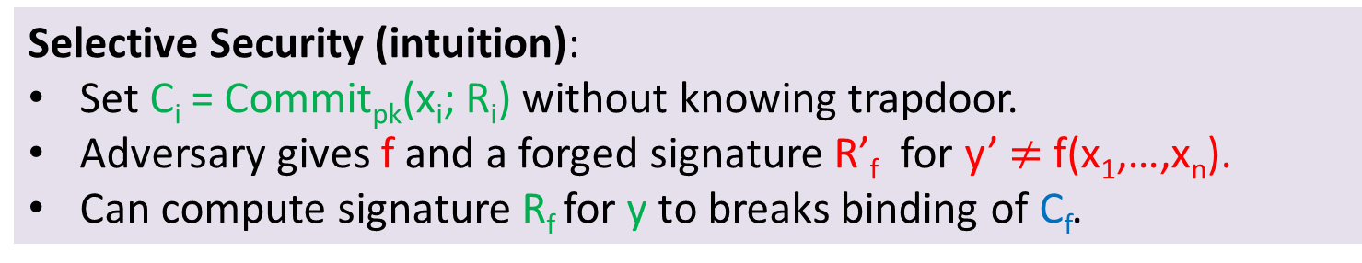
Homomorphic Signature
Public params:
C₁ … C_{n}
random commitments
Verification key: pk
Signing key: td
Sign_{sk}(x₁, …, x_{n}) → σ:
sample R₁,…,R_{n} s.t. Commit(x_{i};R_{i})=C_{i}
Eval_{pk}(f, (x₁,R₁)…,(x_{n}, R_{n}) )→σ_{f,y}
Process_{pk}(f) →pk_{f}
σ_{f,y} := R_{f} = Eval_{open}(f, (x₁, R₁), …, (x_{n}, R_{n}))
Output pk_{f} = C_{f} = Eval_{com}(f, C₁, …, C_{n})
Selective Security (intuition):
Set C_{i} = Commit_{pk}(x_{i}; R_{i}) without knowing trapdoor.
Adversary gives f and a forged signature R’_{f} for y’ $≠$ f(x₁,…,x_{n}).
Can compute signature R_{f} for y to breaks binding of C_{f}.
Verify_{pk}(pk_{f}, y, σ_{f,y}) =1 iff C_{f} = Comm_{pk}(y;R_{f})

Slide 21
Extensions
Full security (beyond selective):
Homomorphic chameleon hash [KR00]
= Homomorphic equivocal commitments.
Multiple data sets:
Use standard signature to sign a fresh verification key of homomorphic signature scheme for each data set.
Context Hiding (certificate only reveals output of comp.)
Can be done generically with NIZKs.
Nice way to do this for our scheme using equivocation trapdoors.

Slide 22
Open Problems
Remove large public parameters?
Remove dependence on depth. Bootstrapping?

Slide 23

Notes:
Comments: add short vector for SIS solution (u-u’)r.
Say that SIS is believed to be hard to certain lattice problems.

